Slide 1
Image to Text to Speech conversion with intonation for regional language.
Under the guidance of Prof. Dr. Madhushankara. M
Presented by: (BDA 11 group)
Pooja C A – 201046012
Karthik Ballullaya MK – 201046029
K. Viswateja - 201046042

Slide 2

Introduction

Slide 3
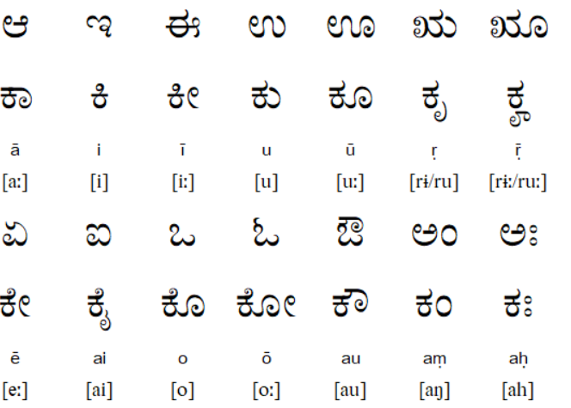
Kannada Language
Kannada ಕನ್ನಡ less commonly known as Kanarese) is a Dravidian language spoken predominantly by the people of Karnataka in south western region of India.

Slide 4
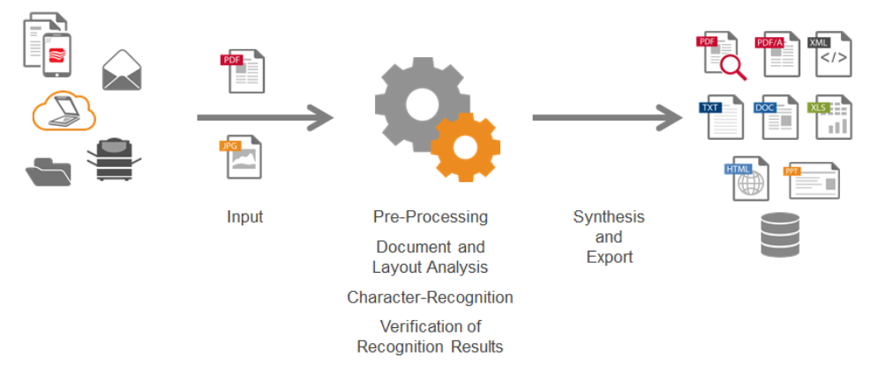
Optical character recognition (OCR)
Optical character recognition or optical character reader is the electronic or mechanical conversion of images of typed, handwritten or printed text into machine-encoded text, whether from a scanned document, a photo of a document, a scene-photo or from subtitle text superimposed on an image.

Slide 5
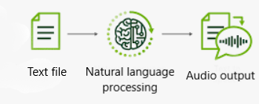
Text To Speech (TTS)
Text-to-speech (TTS) is a type of assistive technology that reads digital text aloud. It’s sometimes called “read aloud” technology.
With a click of a button or the touch of a finger, TTS can take words on a computer or other digital device and convert them into audio.

Slide 6
Our Model Pipeline

Slide 7
Our Model Pipeline
Image as pdf file
Image to Text (Akshara Jaana library)
Text as rtl file
Text to Speech (gTTS library)
Speech as mp3 file

Slide 8
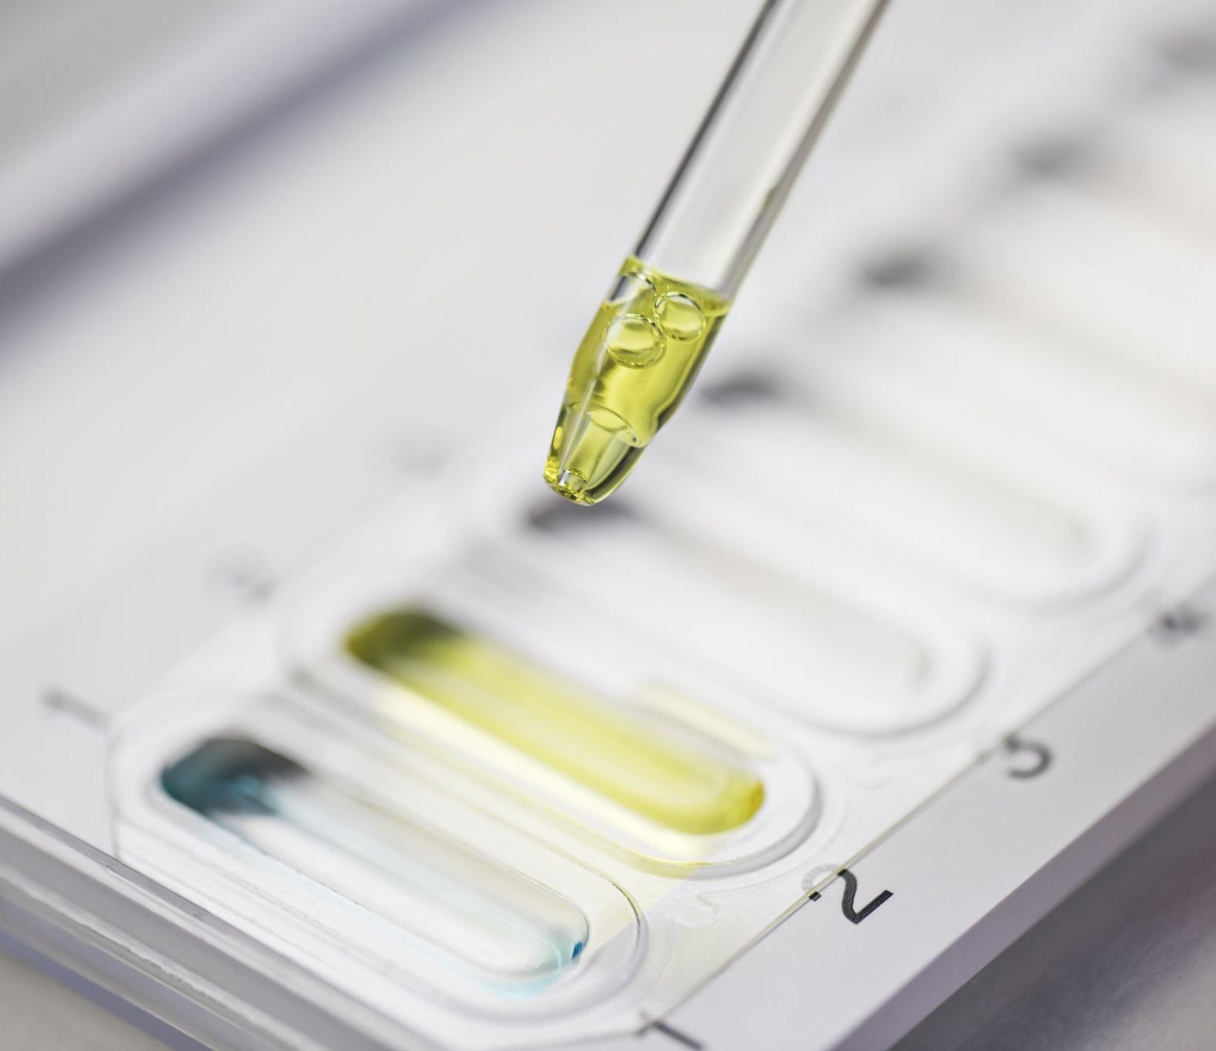
Akshara-Jaana
Image to Text library

Slide 9
Akshara Jaana
AksharaJaana is an Optical Character Recognition software that is jointly developed by the Department of Electronics and Communication, NMAM Institute of Technology, Nitte, Karnataka, India and Kannada GaNaka Parishattu, Bengaluru.
The focus is to add more features to the tesseract ocr engine and make it more user friendly for sindhi languages

Slide 10
Akshara-Jaana Working
Convert pdf to image
Word Segmentation
Character Segmentation
Character recognition
Text output (rtl / html)

Slide 11
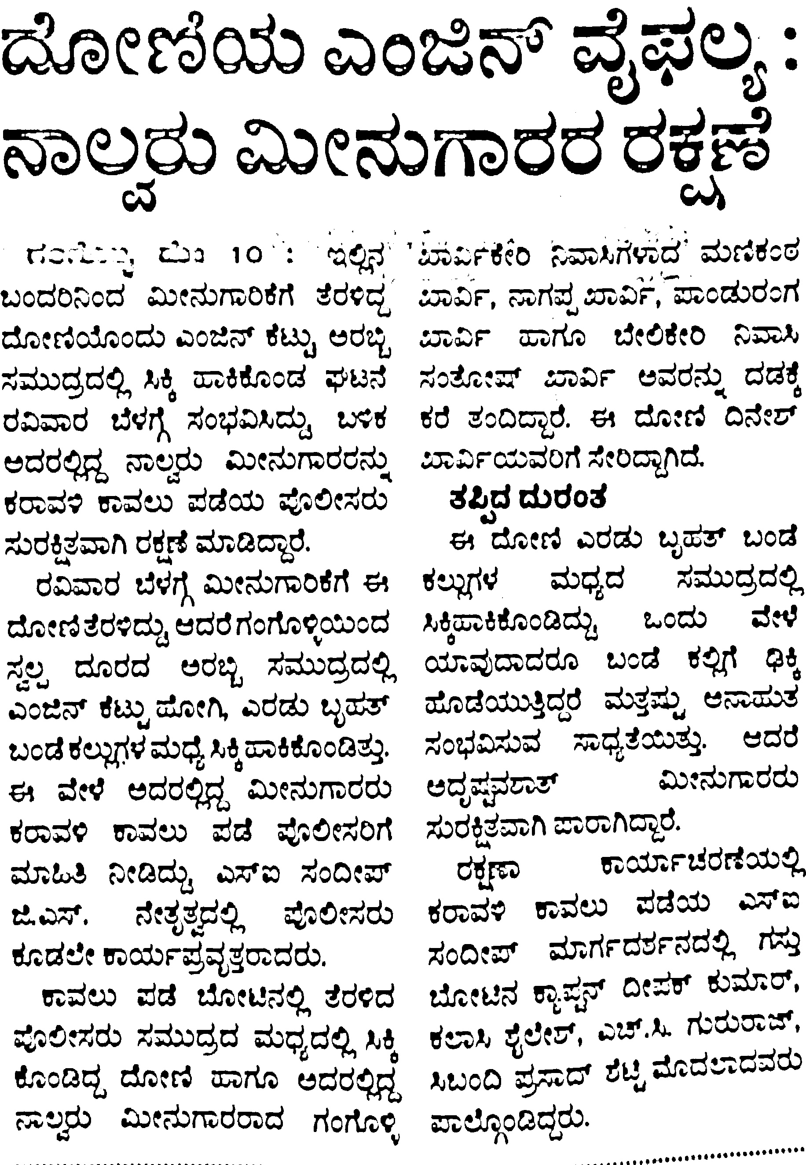
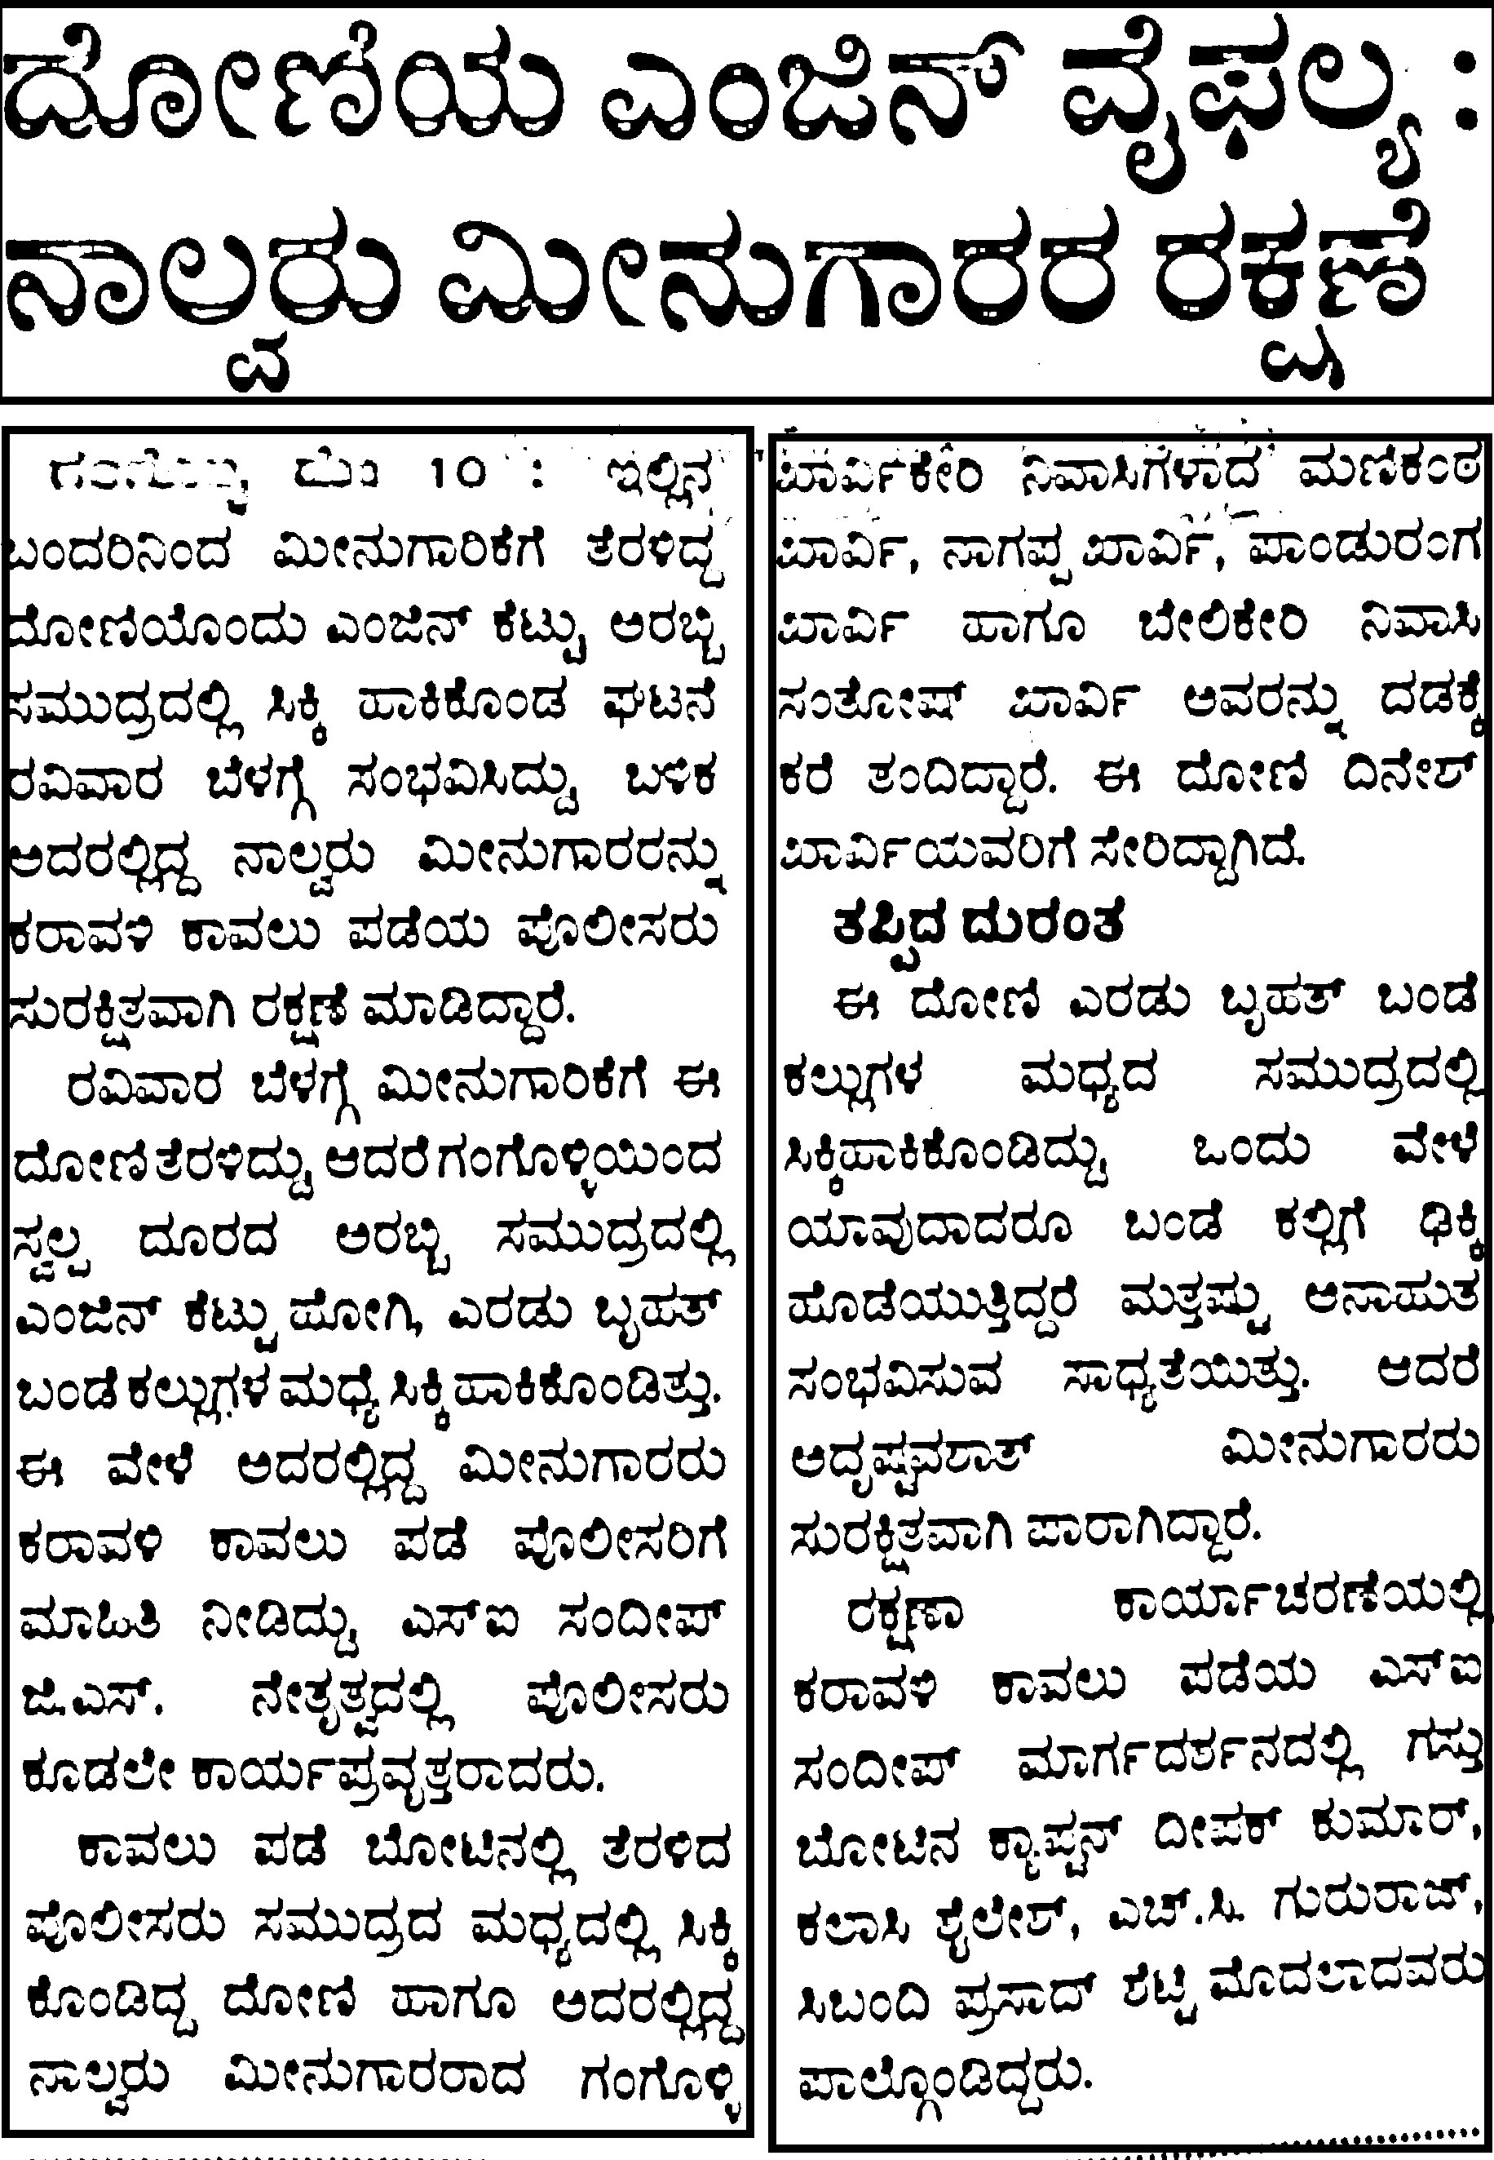
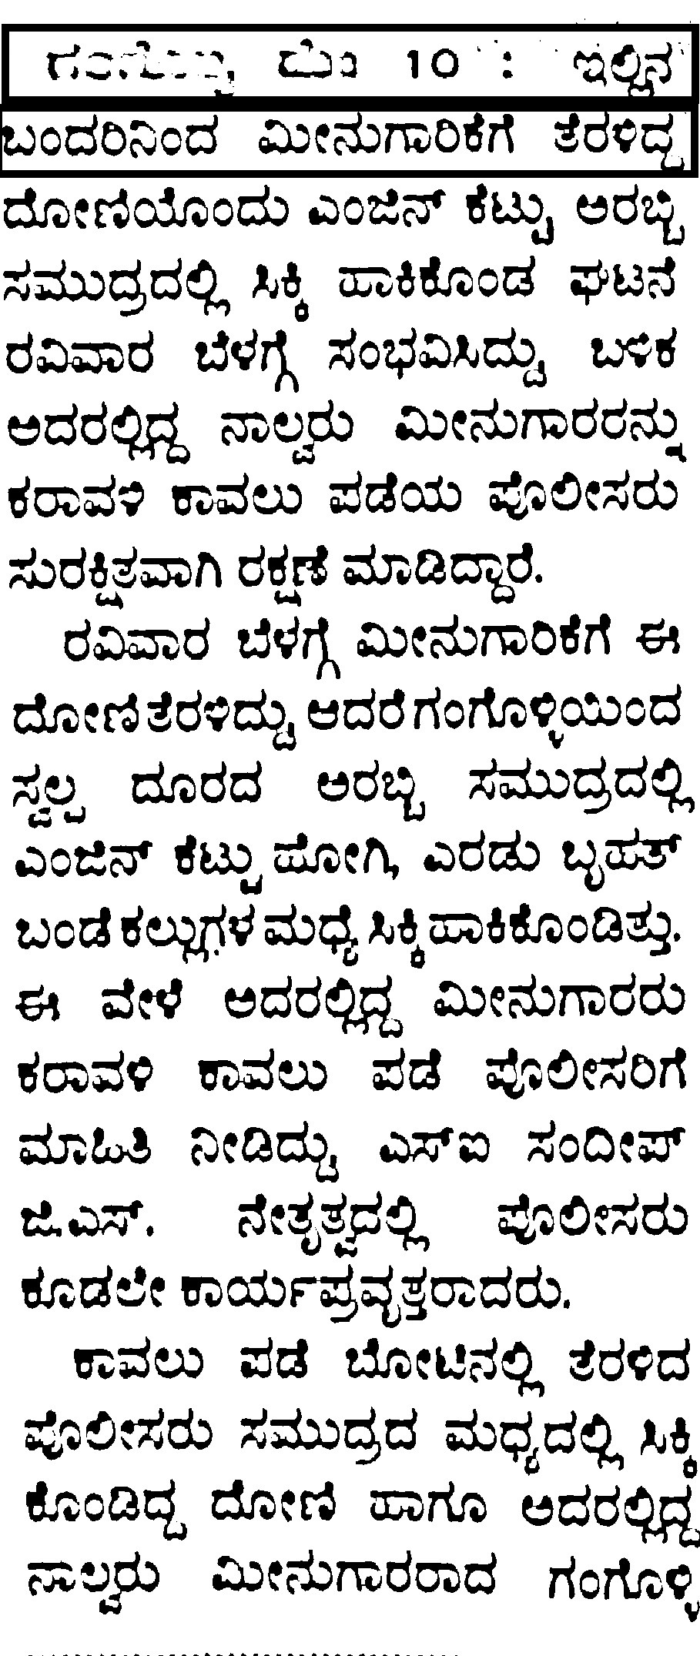
Akshara-Jaana Working
Column, Line Segmentation

Slide 12
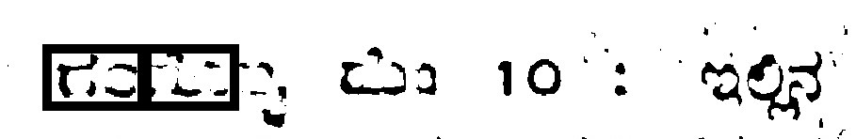
Akshara-Jaana Working
Character Segmentation

Slide 13
gTTS
Text to Speech Library

Slide 14
gTTS
There are several APIs available to convert text to speech in python. One of such APIs is the Google Text to Speech API commonly known as the gTTS API.
gTTS is a very easy to use tool which converts the text entered, into audio which can be saved as a mp3 file.
The gTTS API supports several languages including English, Hindi, Kannada, Tamil, French, German and many more.
The speech can be delivered in any one of the two available audio speeds, fast or slow.

Slide 15
gTTS Working
Pre-processor
Tokenizer
Tokenizer case
Minimizer
Text to speech synthesizer
Speech output (mp3)

Slide 16
gTTS Working
Pre-processor
Function that takes text and returns text.
Its goal is to modify text, and/or to prepare text for proper tokenization.
Tokenizer
Function that takes text and returns it split into a list of tokens.
Its goal is to cut the text into smaller segments that do not exceed the maximum character size allowed for each TTS API request, while making the speech sound natural and continuous.
Splits text where speech would naturally pause while handling where it should not. Such rules are called tokenizer cases.

Slide 17
gTTS Working
Tokenizer case
Function that defines one of the specific cases used by gtts.tokenizer.core.Tokenizer.
More specifically, it returns a regex object that describes what to look for a particular case. gtts.tokenizer.core.Tokenizer then creates its main regex pattern by joining all tokenizer cases with “|”.
Minimizer
The text to speech can take a maximum of 100 tokens for a single API request.
This function splits the strings at
Before 100th token if there is no space between 100th and 101st token.
At 100th token.
Before 100th if it finds a natural pause in the sentence

Slide 18
Applications
Aid the visually impaired by offering a computer-generated spoken voice that would “read” text to the user.
People with learning disabilities due to dyslexia or other problems really benefit from TTS, offering them an easier option for experiencing website content.
People who are trying to learn another language are benefited by TTS technology which allows them to understand information in a way that makes content easier to retain.
TTS allows people to enjoy and provides an option for content consumption on the go.
OCR are used in data entry for business documents, e.g., Cheque, passport, invoice, bank statement and receipt.
OCR is used in Automatic number plate recognition.
OCR are also used in Converting handwriting in real-time to control a computer (pen computing).

Slide 19
References
gTTS documentation (Link)
Akshara Jaana library (Link)

Slide 20
Thank you

